Slide 1

UNDERSTANDING THE SOCIAL/COMMUNITY BODY

Slide 2
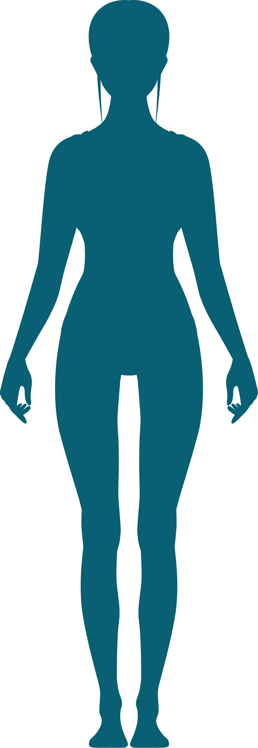



THE 5 BODY THEORY
Physical
Emotional
Mental
Spiritual
Social

Slide 3

COMMUNITY MATTERS

Slide 4
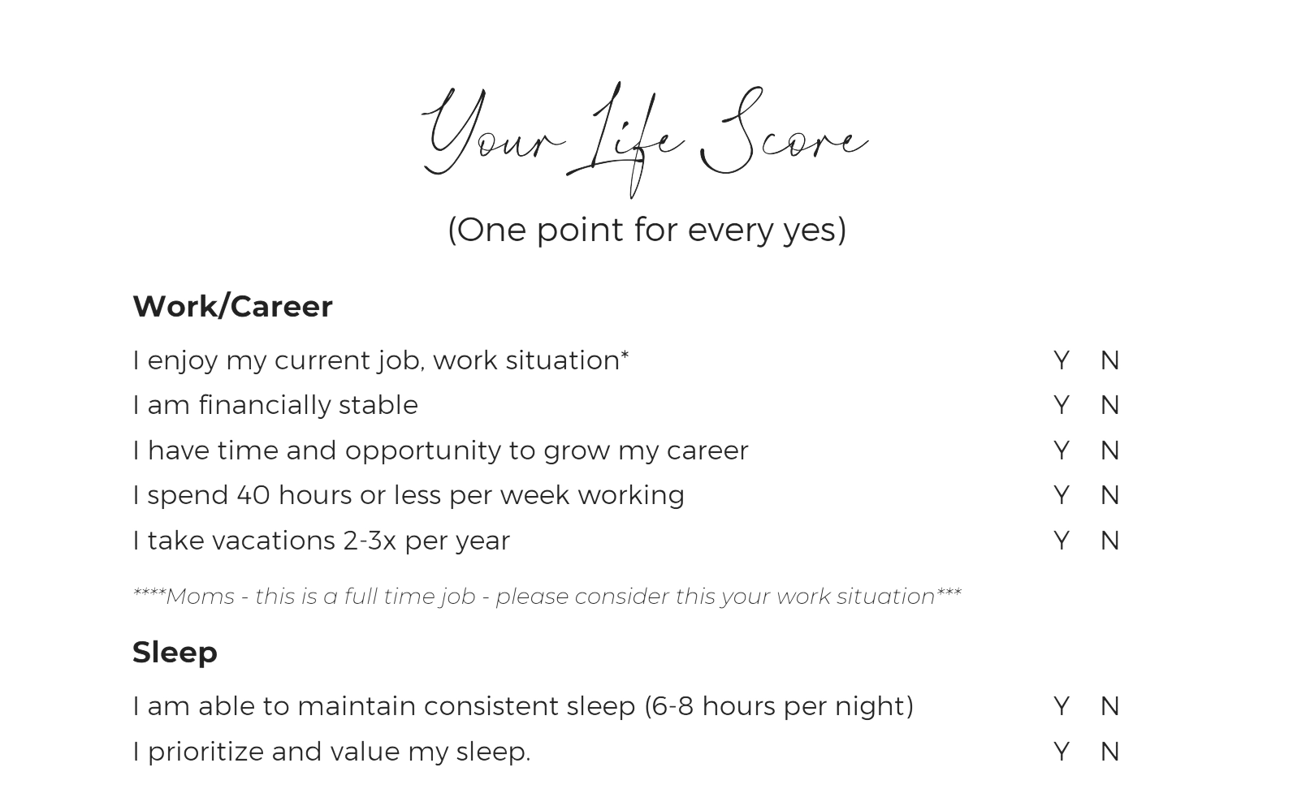
LIFE INVENTORY CHECKLIST
PART ONE

Slide 5
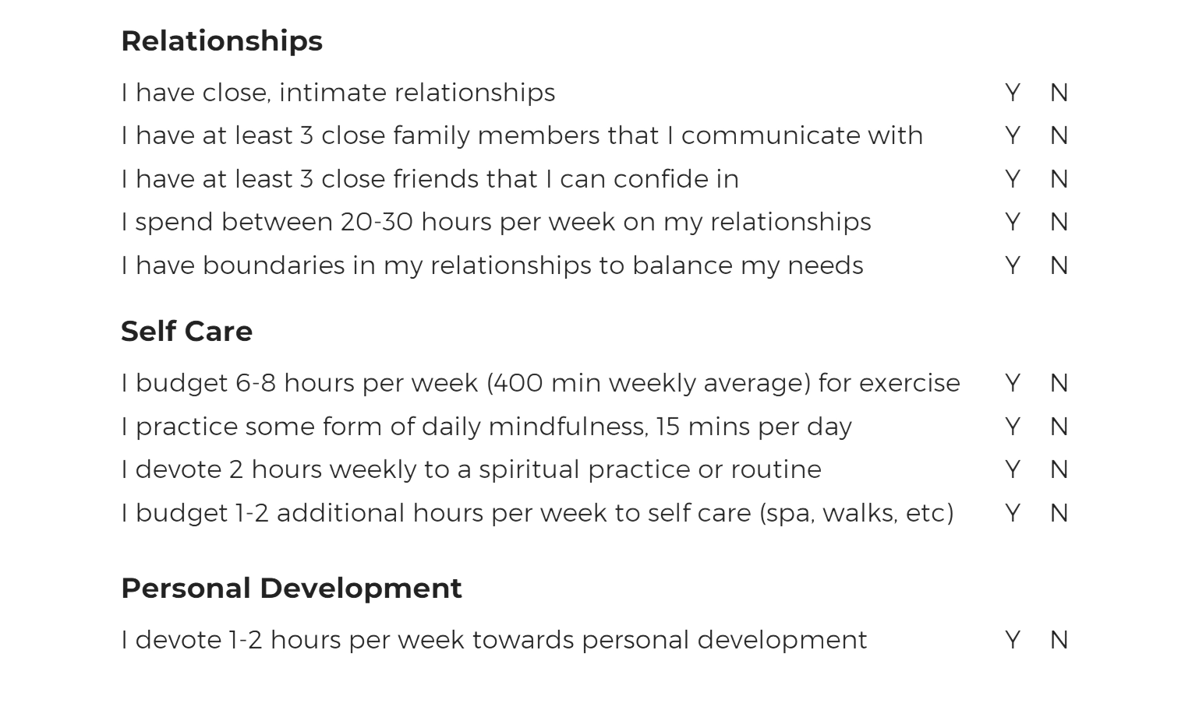
LIFE INVENTORY CHECKLIST
PART TWO

Slide 6
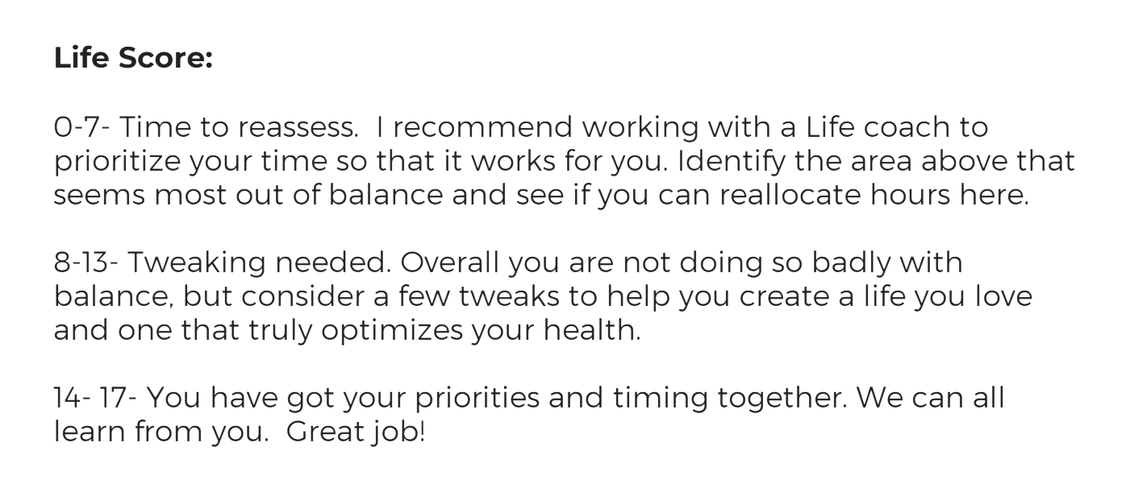
LIFE INVENTORY CHECKLIST
YOUR RESULTS

Slide 7
TAKE A LOOK AT YOUR PERSONALITY TYPE
THE MYERS-BRIGGS TYPE INDICATOR ASSESSMENT
THE ENNEAGRAM PERSONALITY TEST

Slide 8
Your PowerType
My body build is best described as:
Slender and/or thin
Thin with some muscle
Medium with good muscle tone
Thin to medium with some muscle loss
Medium to large, with areas of fat deposition
Score:
+1
+2
+3
+4
+5
FIND YOUR POWER TYPE
My hair Is best described as:
Thin & sparse
Thin but of average volume
Medium volume
Falling out; I am losing hair
Full and abundant volume
Score:
+1
+2
+3
+4
+5
My weight:
Remains consistently low (I am lean and have trouble gaining weight)
Fluctuates (I gain or lose easily)
Is fairly consistent as long as I work out
Decreases when I’m stressed or overworked
Is stubborn (I gain easily and tend to be overweight)
Score:
+1
+2
+3
+4
+5
My hair Is typically:
Dry
Dry with areas of oiliness (such as the central scalp)
Slightly oily (I need to wash daily)
Oily on the scalp with dry, brittle ends overall
Luxuriant and shiny (I can wash every 3 or 4 days)
Score:
+1
+2
+3
+4
+5
My energy is:
Irregular—I alternate between high highs & low lows
Consistent, but I occasionally crash or become overwhelmed
Consistently positive (I feel on top of the world!)
Low—I have trouble getting going
Just okay—I have more days of feeling low energy than high
Score:
+1
+2
+3
+4
+5
My skin is usually:
Dry and quick to wrinkle
Oily with areas of dryness
Oily
Dry with patches of oiliness
Moist and firm
Score:
+1
+2
+3
+4
+5
In terms of sleep patterns:
I am up all night—I do my best work at night.
I am up super early in the morning, before everyone else—I hear the birds!
I am awake as the day breaks, usually the same time every morning.
I need more sleep than I did in the past and am often in bed before everyone else.
I always oversleep—it’s tough getting out of bed, even though I sleep through the night.
Score:
+1
+2
+3
+4
+5
When I touch or pull my skin:
It feels dry and rough
There are areas of roughness
It is moist and oily, with breakouts
It is dry and irritated or inflamed
It is moist and responds to pressure easily
Score:
+1
+2
+3
+4
+5

Slide 9
I typically go to sleep:
Past midnight
Between 11 p.m. and midnight
Between 10 p.m. and 11 p.m.
No later than 10 p.m., and sometimes earlier
In bed by 10 p.m. or before.
Score:
+1
+2
+3
+4
+5
My belly issue is:
Bloating, gas, and diarrhea
Occasional discomfort
Abdominal pain or constipation
Occasional constipation or diarrhea
Abdominal weight gain, indigestion, bloating
Score:
+1
+2
+3
+4
+5
When I do have trouble with sleep, it is most often because:
My mind is restless and anxious.
I worry about my to-do list and that my tasks won’t get done.
I stay up too late trying to get too much done before bedtime.
I don’t feel rested in the morning. I feel drained and can’t get caught up because I’m too tired.
I wake up wanting to stay in bed all day. I either procrastinate or lack motivation.
Score:
+1
+2
+3
+4
+5
I am:
Frequently cold or easily chilled
Occasionally cold or chilled
Usually comfortable, but sometimes warm
Someone who fluctuates between being cold and hot
Easily overheated
Score:
+1
+2
+3
+4
+5
My cycles are:
Irregular or non-existent
Regular but light
Regular
Irregular but heavy
Very heavy - I sometimes see clots
Score:
+1
+2
+3
+4
+5
My thinking patterns are:
Erratic. I have trouble focusing and sustaining thoughts.
Sharply unfocused. I can do many tasks at once but have to train my brain to stay on task.
Razor sharp. I am usually on point and able to finish my to-do list.
Densely hazy. I often feel brain fog or overly burdened.
Periodically foggy. I can forget things occasionally.
Score:
+1
+2
+3
+4
+5
I can best describe my overall mood as the following:
I am usually anxious and nervous.
I am prone to anxiety, but only when stressed.
I can be irritable and very angry when stressed—yes, that is me yelling.
I can have waves of depression and anxiety.
I do get depressed often.
Score:
+1
+2
+3
+4
+5

Slide 10
I cry:
Easily
Only when fatigued
Rarely
Hardly ever or never
Often
Score:
+1
+2
+3
+4
+5
Your PowerType
In a relationship, I crave:
Romance—bring on the flowers, cards, and passion
Some romance, some intellectual stimulation, and some solitary time to recharge
A mental equivalent
A nurturing partner who sees the world as I do
Warmth and reassurance
Score:
+1
+2
+3
+4
+5
My favorite comfort foods are:
Salty—potato chips
Both salty and sweet—potato chips and chocolate
Spicy foods
Fried foods
Sweets - ice cream and chocolate
Score:
+1
+2
+3
+4
+5
I seek and enjoy:
Creative work
The opportunity to build teams, companies, and projects
The opportunity to lead a team, company, or project
Meaningful work that gives back to society or impacts the world in a lasting way
Service-based work—caring for the sick, elderly, or children, as an example
Score:
+1
+2
+3
+4
+5
YOUR SCORE
ADD UP EACH ANSWER SCORE TO
CALCULATE YOUR OVERALL SCORE.
I am most prone to having:
A pallid skin tone or complexion
Under-eye circles
A thick, yellow-coated tongue
Swollen joints
A white-coated tongue
Score:
+1
+2
+3
+4
+5

Slide 11




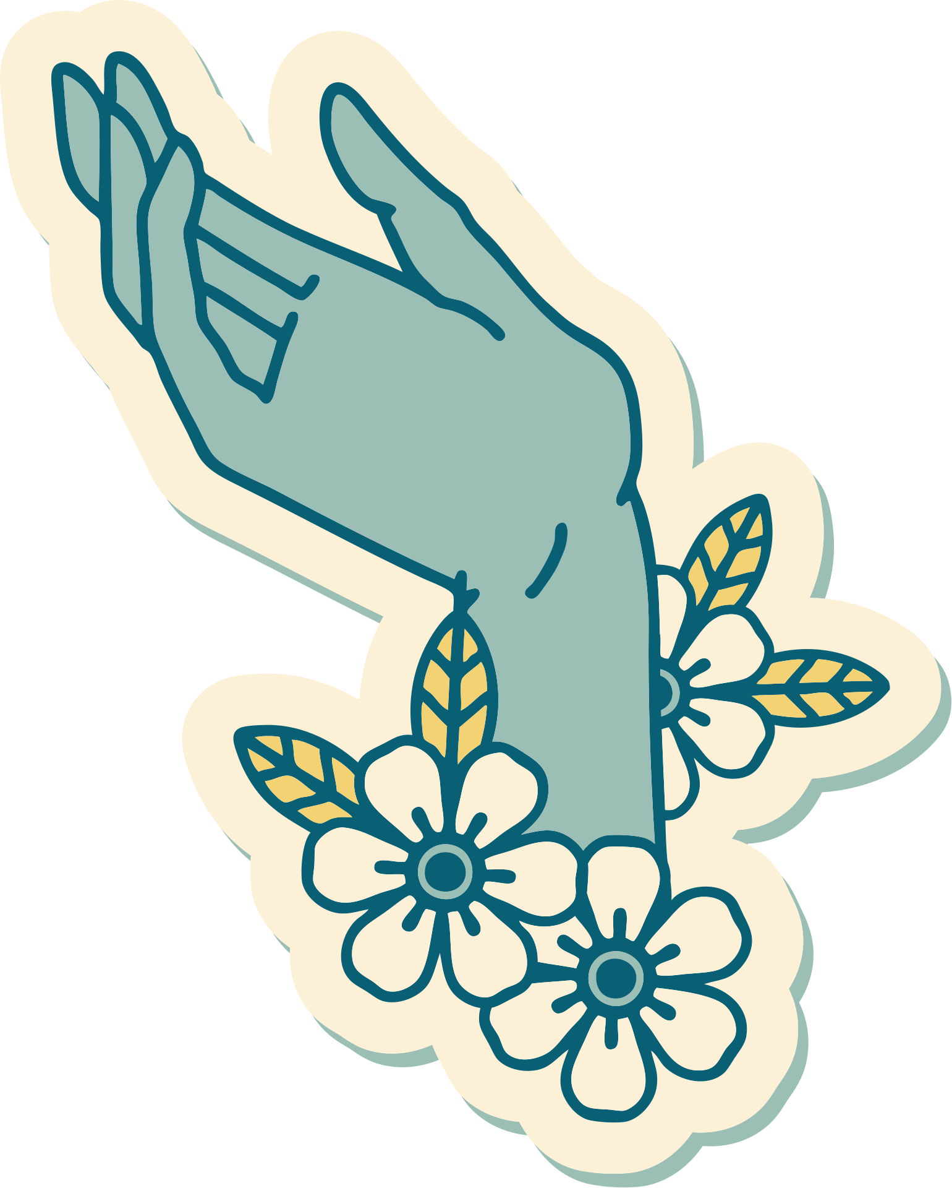

Results
52 - 67: You're a boss lady!
As a Boss Lady, your health challenges tend to revolve around digestive issues. Irritable bowel, acid reflux/heartburn, constipation and more can negatively impact your energy, sleep, weight and hair quality.
0 - 35: You're a gypsy girl!
As a Gypsy Girl, you may be prone to anxiety, inconsistent sleep, up and down energy, eating/diet challenges, ADHD (or concentration issues in general), thinning hair, dry skin and achy joints.
68 - 83: You're a nightingale!
As a Nightingale, your selfless nature can lead to depleted energy levels, a weakened immune system and chronic inflammation. This can result in many other long-term health conditions that Nightingales must watch for.
36 - 51: You're a savvy chick!
As a Savvy Chick, you’re especially harmed by the one-size-fits-all perspective that permeates mainstream health advice. That’s because your constitution can go back and forth between power types, requiring extra attention on your body’s needs, on a day-to-day basis.
84 - 100: You're an earth mama!
As an Earth Mama, you may ignore your own body’s own needs, while taking care of everyone else. This can lead to stubborn weight, low energy, heart issues and even depression.

Slide 12
FIX MY FAMILY: THE HOL+ FAMILY ASSESSMENT
MIND/MOOD
1. You can repeat a sentence backwards.
2. You can read a book, newspaper or magazine for 30 minutes.
3. In any given week, you have more than 4 good days.
BODY
4. You have kept your weight stable over the last 5 years ( within a 5 lb range).
5. You are sick no more than 3x per year.
GI
6. You have regular, daily bowel movements.
7. You rotate your breakfasts, lunches and dinners every 3 days (at least).
8. You do not have reflux, abdominal pain, or frequent gas.
SKIN
9. You have no rashes, liver spots (cherry hemangiomas), or acne.
10. You have no changes in skin pigmentation.
HAIR
11. You have consistent hair density and texture.
Y N
Y N
Y N
Y N
Y N
Y N
Y N
Y N
Y N
Y N
Y N

Slide 13
FIX MY FAMILY: THE HOL+ FAMILY ASSESSMENT
MUSCLE
12. You complain of muscle aches and pains no more than 1-2x per month
13. You do not have frequent injuries or accidents.
ENERGY
14. You have consistent energy through a given day.
SLEEP
15. You sleep at least 7 hours 5 nights per week.
WOMEN
16. You have regular, consistent menstrual cycles (if under 45) without the use of supplemental hormones.
17. You have your hormone levels checked every 2 years.
CHILDREN
18. Your children do not have allergies, eczema or asthma.
19. Your children are not sick more than 3x per year.
20. Your children are conscious about their sugar intake.
Y N
Y N
Y N
Y N
Y N
Y N
Y N
Y N
Y N

Slide 14
NOW, FOR THE RESULTS…
Y=2 points
N=1
34-40- Congrats- You/Your family meets our Get Healthy requirements!
28-34- Not Bad- You/Your family is overall ok, but could use a few changes to help maximize health.
Less than 28- NEEDS WORK- there are many ways to improve you/your family's health. Join our community to learn more tips and tricks or be a Hol+ patient.

Slide 15
CLICK HERE

Slide 16

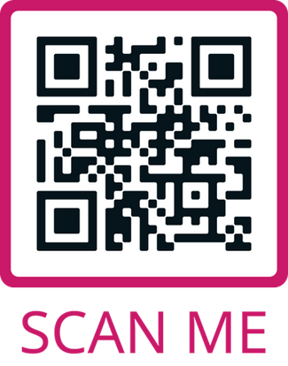

LET'S CONNECT!
Visit: www.doctortaz.com/superwoman-circle
TheEastWestWay.com

